Slide 1
Self-Driving Car
Musketeers
16 March 2016

Slide 2
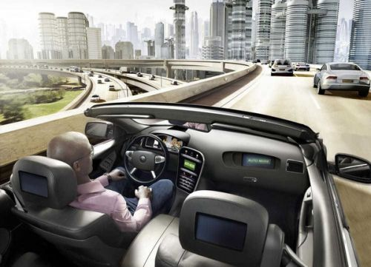
Introduction
Wonderful vision
Unremitting effort

Slide 3
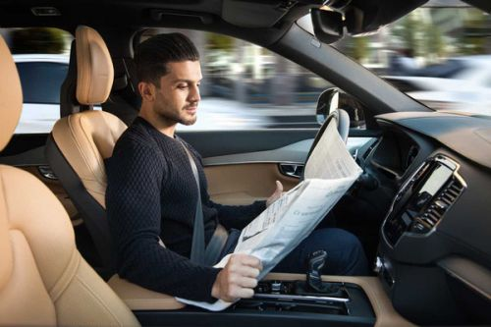
Introduction
Safer and freer lives

Slide 4
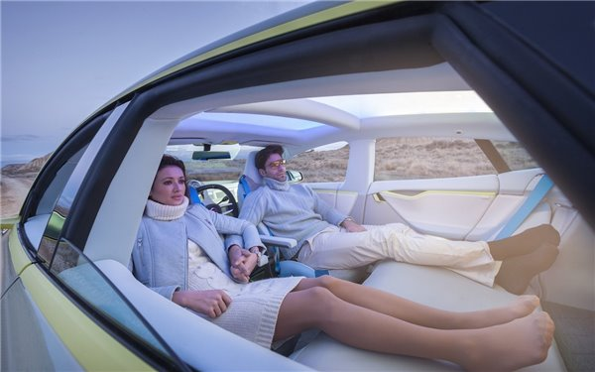
Introduction
Safer and freer lives (can’d)

Slide 5
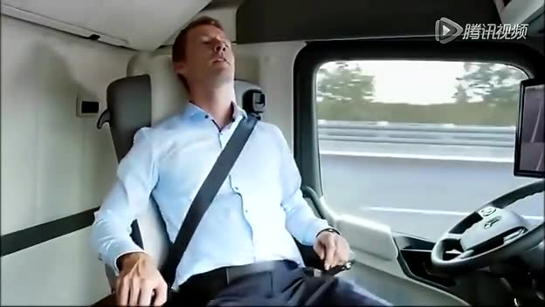
Introduction
Safer and freer lives

Slide 6
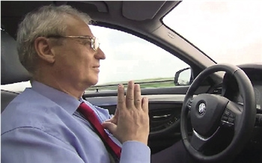
Introduction
Opportunity for elderly

Slide 7


Introduction
Opportunity for us

Slide 8
Applications
Current usage of Self-Driving Car
Overall review of the technology
Features & Concerns

Slide 9


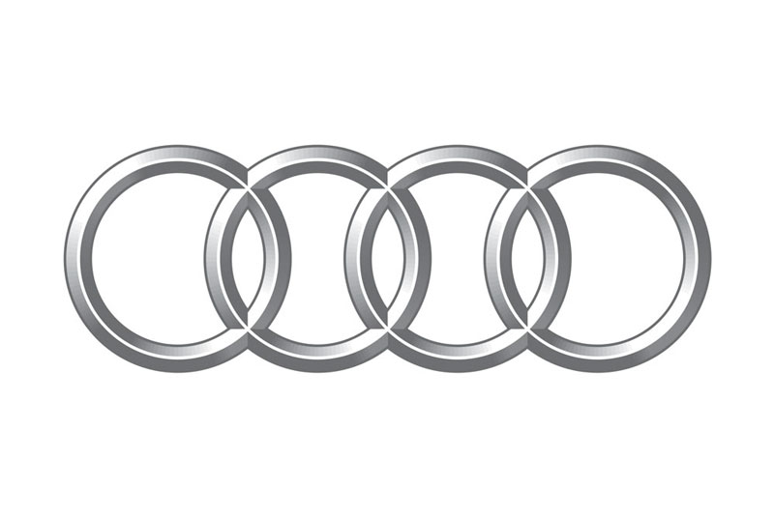

Applications
Current Usage
Business / Daily use
Military

Slide 10
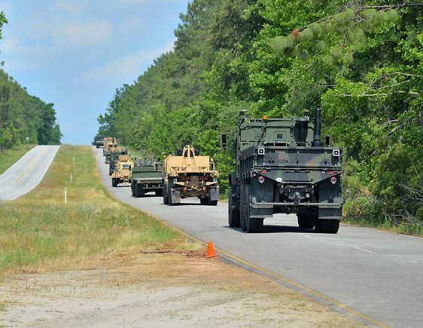
Applications

Slide 11
Applications
Overall review
Still not ready
Traffic accidents reported to CA DMV – February 2016

Slide 12
Projected Development
Current Automotive Leaders in Autonomous Technology
Subaru
Volvo
Nissan
Ford
Mercedes-Benz
Google
- hoping to have their cars to market by 2017
Others hoping to follow by 2020

Slide 13
Projected Development
Investment
Tens and hundreds of millions invested so far
Some car companies have pledged a billion dollars over the next few years
US investing $4 billion over the next 10 years

Slide 14
Projected Development
Opportunities
By 2030, $87 billion worth of opportunities
Software companies like Google and IBM stand to win big
Software
- $2.1 billion in sales in 2014
- $63 billion in 10 years

Slide 15
Projected Development
The technology is categorized as Levels 1 to 4
Currently and up to 2030, there will primarily be Level 1 and Level 2 features
Level 3 and Level 4 are more advanced features; Level 4 is fully autonomous
This means that software development is far from over

Slide 16
Projected Development
Google is on a hiring spree
Sebastian Thrun, the brains behind Google’s driverless car program, said that the software was written in C++
He also offers his own introductory online course in artificial intelligence programming utilizing the language Python

Slide 17
Bibliography
Birdsall, Michelle. "Google and ITE: The Road Ahead for Self-Driving Cars."Institute of Transportation Engineers.ITE
Journal 84.5 (2014): 36-9. ProQuest.Web. 20 Feb. 2016.
Claburn, Thomas. "Self-driving cars." InformationWeek. UBM LLC, 7 July. 2014. Web. 11 Mar. 2016.
Google Inc. “Monthly Report” Google Self-Driving Car Project, n.d . Web. 11 Mar. 2016
“Investopedia Stock Analysis: How Google's Self-Driving Car Will Change Everything.” Chatham: Newstex, 2014. ProQuest. Web. 28 Feb. 2016.
“Hybrid Cars: Feds Pledge $4B to Accelerate Self-Driving Car Development.” Chatham: Newstex, 2016. ProQuest. Web. 28 Feb. 2016.
“Autoblog: Google's Self-Driving Car Project is on a Hiring Spree.” Chatham: Newstex, 2016. ProQuest. Web. 28 Feb. 2016.
“Click. IBD's Technology Blog: Google, IBM Software Likely to Rev Up Self-Driving Cars.” Chatham: Newstex, 2014. ProQuest. Web. 11 Mar. 2016.

